Slide 1


Bryson Turner, Logan Wright, Daniel Garzon, Sammuel Clark

Slide 2
FUN for Kids
EASY for Parents
Goal

Slide 3
PGA Family
In sports, your team is your family. With PGA Family Golf, your family is your team.
In sports your team is your family, in PGA Family Golf, your family is your team

Slide 4
Case Focus
PGA of America is having difficulty getting PGA professionals to adopt the PGA Family program at their local course.
Some PGA professionals are doing one of the following:
Adopting the program under the PGA Family logo
Adopting the program as a separate program not under the PGA Family logo
Not adopting the program in any form

Slide 5

Making PGA Family Something Bigger
Motivate PGA Professionals
Implement the program at their local course under PGA Family Logo

Slide 6
The Fan Journey
Beginner
Parent
Awareness
Attractiveness
Attachment
Allegiance
Person who may not have golfed before gets convinced to come to PGA Family event.
Developing perception by playing the mini games & tournament.
Attending a single PGA Family event.
Purchase a PGA Family (or just golf course) membership.

Slide 7
The Role of the
PGA Professional in PGA Family

Slide 8

ROLE #1: Educator
Fundamental knowledge of the game of golf to conduct group lessons for players of all skill levels, to encourage player development
Analyze player’s stance, swing mechanics, and overall performance to provide feedback and guidance to identify areas for improvement
Utilize the resources of PGA player development programs such as Get Golf Ready, PGA Sports Academy, Tee it Forward, etc.
Notes:
Awareness step of Fan Journey

Slide 9
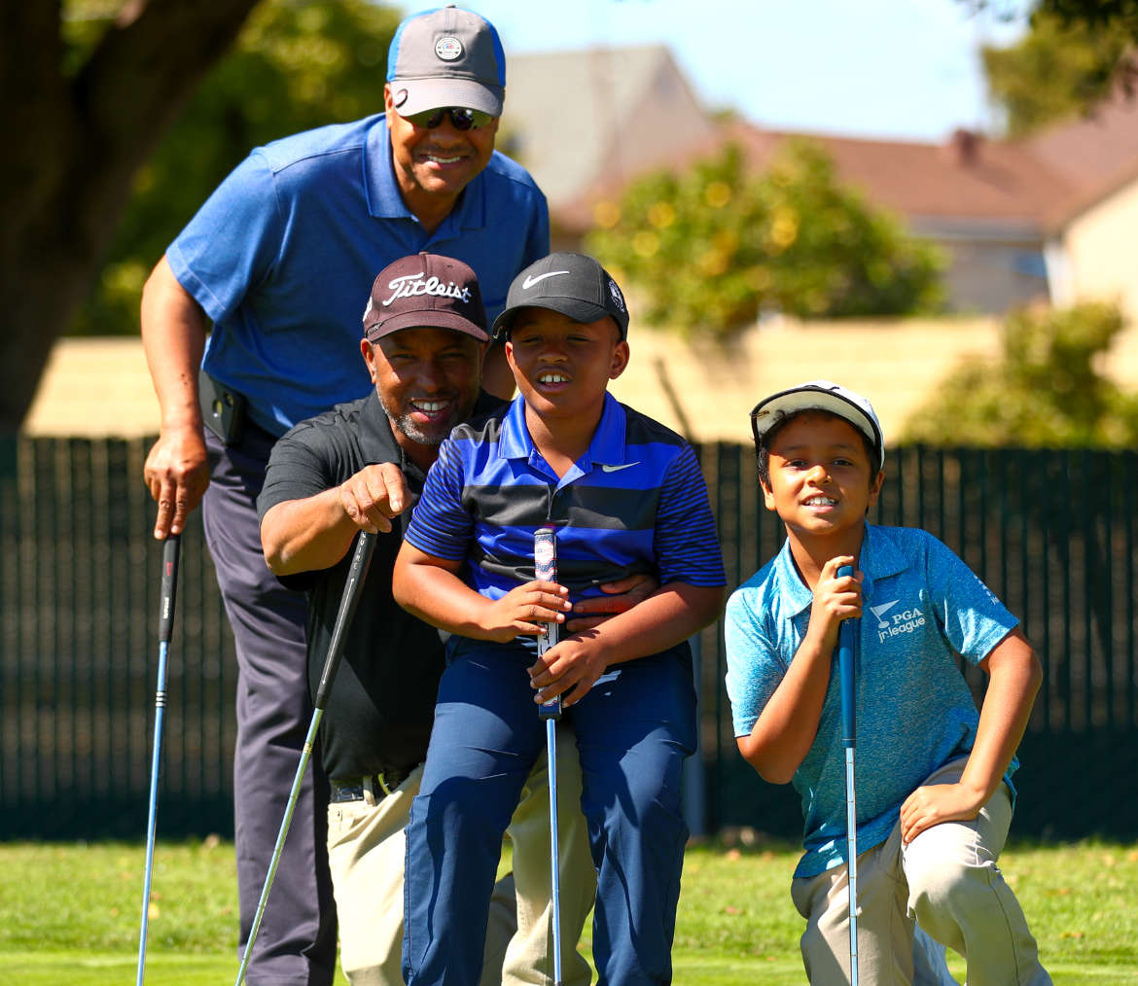
ROLE #2: Facilitator
Oversee an enhanced golf instruction program and promote a positive professional image within the community
Build rapport and foster positive relationships with clients through effective communication and responsiveness to create a memorable experience for golfers of all ages and skill levels
Fundamental supervisory practices and principles
Notes:
Attachment Step of Fan Journey

Slide 10
How can PGA Family impact green fee revenue and membership?

Slide 11
PGA Family can make the golf course a family’s Third Place:
Third Place: the social surroundings that are separate from the two usual social environments of home and the workplace.
Needs for a Third Place: Convenience and Interaction
Design Implementations | Example
Promote Intra-Family Interaction | Parent-Child Scrambles
Promote Inter-Family Interaction | Family vs. Family Scrambles
Smooth Customer Service | On-Course Hotline for food/beverage/other needs

Slide 12
Connections and Memories = Later Nostalgia
Golfer purchases a membership
Beginner Golfer remembers memories on the golf course
Brings Family (ft. a beginner golfer) to the golf course with a PGA Family event
Cycle of Nostalgia
Beginner Golfer form fond memories of the golfing experience
Notes:
Drive membership because of the memories created with family members. Regardless of skill, membership will be viewed as a way to spend quality time with family while developing skills in golf

Slide 13


Slide 14
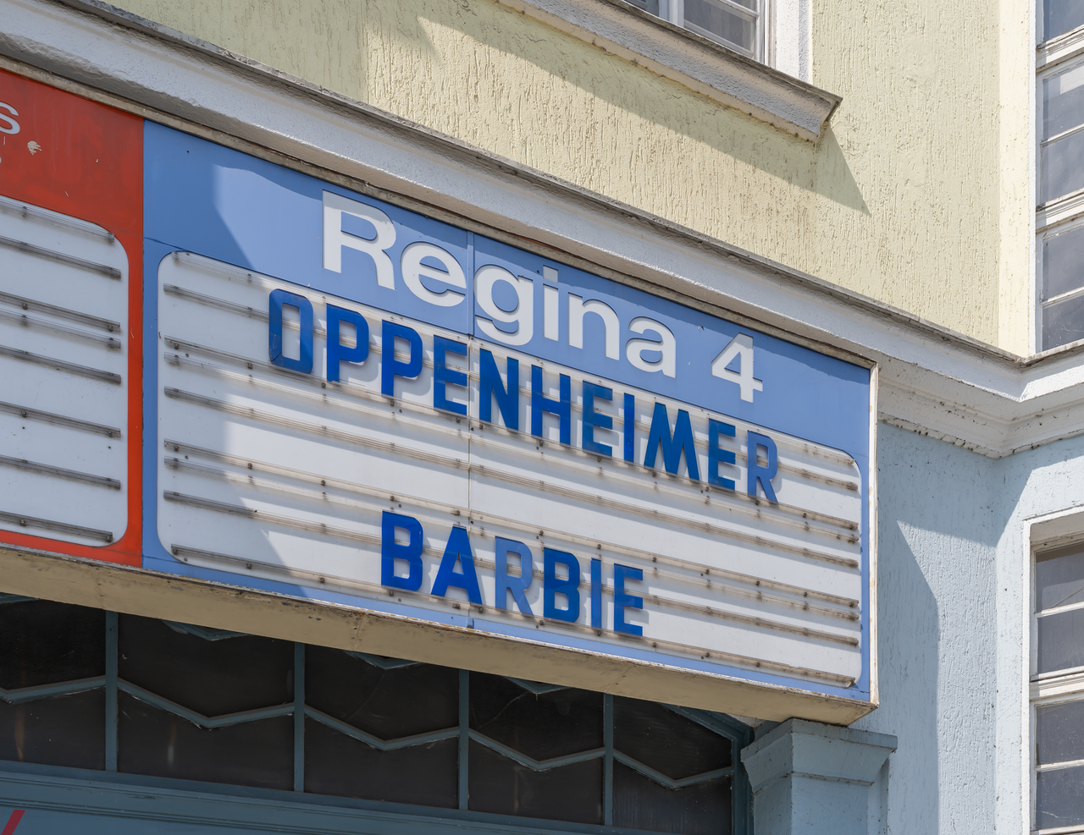
Make PGA Family Events “Can’t Miss” Ones
With some professionals already adopting the PGA Family program, making their programs successful can induce a sense of FOMO (“Fear of missing out”) in skeptics/stragglers.
For families, the “can’t miss” comes from a sense of opportunism.
You can’t miss this event because it’s your best chance to get your family on the course.

Slide 15


Pricing Perspective:
Single-Event Bundle: (Single day)
Cater to event theme
Rentals included
Having green fee included
Single use
Family Membership: (Long term)
To go to every event that you want
For people that want to do it regularly
Flat rate family of four and additional fees
Benefits:
discounts merches and activities
Food and Beverage passes
Rentals
Green fee included
Notes:
Benefits:
Same benefits as individual membership for up to four to six family members (e.g., spouse and children).
Additional discounts on guest fees for family members.
BRYSON NOTES:
Single-Day Bundle is All wrong. Family Fun Day Bundle is just one example of a Single-Day Bundle. You need to be more general with it.
Family Membership: It’s like a bundle of memberships. Ex. 4 members of family = cost of 2 memberships.
PGA

Slide 16
Food & Beverage
Notes:
Exclusive Dining Events:
PGA Family members could enjoy exclusive dining events hosted at the club's restaurant or partner establishments. These events could include themed dinners, wine tastings, chef's table experiences, and holiday brunches.
By offering unique and curated dining experiences, PGA Family encourages members to dine at the club and strengthens their sense of community and belonging.
Customized Culinary Programs
With local chefs
educational and interactive culinary experiences
Focus on food and beverage lovers

Slide 17
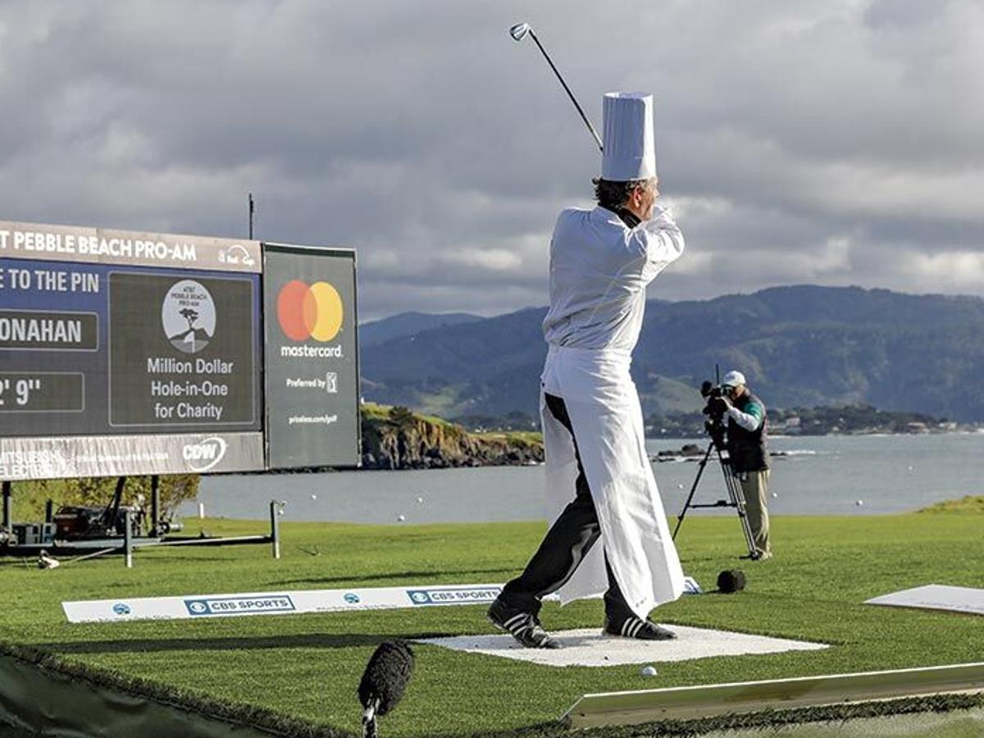

Dining Experience:
Mobile Ordering and Delivery:
Implement a mobile ordering method and delivery platform that allows for on-course delivery
Designated stations on the course with QR codes/App for menu options
Spend more time enjoying the club's amenities
Notes:
Specialized Alcohol Beverage Provided for the event:
Alcohol is the #1 seller for the golf course
Provide premium and variety of options can catch consumers eyes
For example: themed dinners, wine tastings, chef's table experiences, and holiday brunches.
Family Style Dining Experience:
This can be hosted at clubhouse restaurants or partnered with Premium dining restaurants
collaborate with local chefs or culinary experts
Big portions for the table
Shareables
Kids menu
Mobile Ordering and Delivery:
PGA Family could implement a mobile ordering and delivery platform that allows members to place food and beverage orders from their smartphones and have them delivered directly to their location on the golf course or at the club facilities.
By offering convenient and contactless dining options, PGA Family enhances the overall dining experience for members and encourages them to spend more time enjoying the club's amenities.

Slide 18
Golf Equipment Rentals and Sales

Slide 19


Equipment Rentals and Sales:
Play and Rental Bundles:
Offering a different avenue
Bundling prices together to offer value through pricing of playing and rental equipment
Discounted green fee to play with the choice of renting clubs
Kids Club Rentals at No Fee:
Complimentary kids club rentals to its members
For kids under 12 years old
Long Period Rentals:
Prefer extended use of equipment, such as monthly or seasonal rentals.
Opt for long-term rental benefits
Notes:
Kids Club Rentals at No fee:
By providing free kids club rentals, PGA Family encourages families to participate in golfing activities together, fostering a love for the sport among younger generations and creating a positive experience for the entire family.
Long Period Rentals, Bundles, and Discount Rates:
Discounted cost!!!!!
prefer extended use of equipment, such as monthly or seasonal rentals. Members who opt for long-term rentals could receive discounted rates compared to short-term rentals.
By offering discounted rates and flexible rental options, PGA Family encourages members to rent equipment for longer periods, increasing revenue from rental services and enhancing member satisfaction.
(increase loyalty through accessibility and retention)

Slide 20
Other Revenue-Earning Operations

Slide 21



PGA Family Spin-Off Events
Mini-Games:
Various aspects of golf
Having different groups that classify the different skills levels
Beginners (Awareness)
Intermediate (Attractiveness)
Expert (Attachment and Allegiance)
iSpy (Congo River)
Checklist of spotable items without the course
Theming:
Cater the theme towards children and family environment
Ex: Hawaiian, Halloween
Board Augmented Reality:
To correct your form
Notes:
Mini-Games:
such as putting accuracy, driving distance, chipping accuracy, and bunker shots.
ISPY(Congo River):
Kids think about through the game
Customizable Course:
Cater the theme
Board of AI:
Correct your form

Slide 22
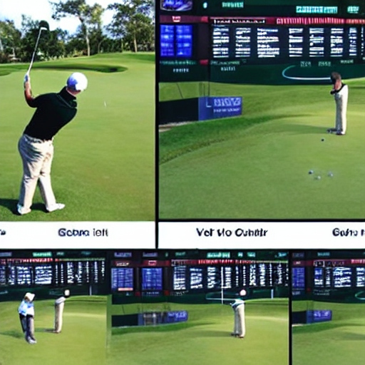
Incorporate use of Augmented Reality 4
Use of AI to correct form
Have professional PGA golfers involved in development of technology to be able to market it better

Slide 23
Implications for PGA Professional’s World
Notes:
•What are two implications of these numbers related to PGA professional adoption of PGA Family?
•For implications that are an opportunity, how could promotion be used to maximize their impact?
•For implications that are a threat, how could promotion be used to minimize their impact?

Slide 24
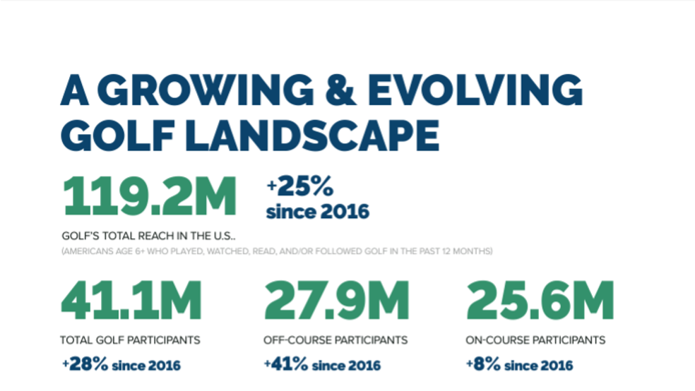

Slide 25
Implications
-Difficulty getting PGA professionals to adopt the PGA Family program at their local course /although reach increased, only 34% participate/ on course participants low (8%)
-Opportunity, how promotion maximizes their impact
Social Media & PGA Professionals (video board AI)
-Threat, how promotion minimizes their impact
Promote prices to have more golf participants

Slide 26
Boosting Economic Activity
Notes:
•How could place of PGA Family be designed to positively impact one of these areas of economic activity? What would access look like? What would assistance look like? What would assortment look like? What would aesthetics look like?

Slide 27
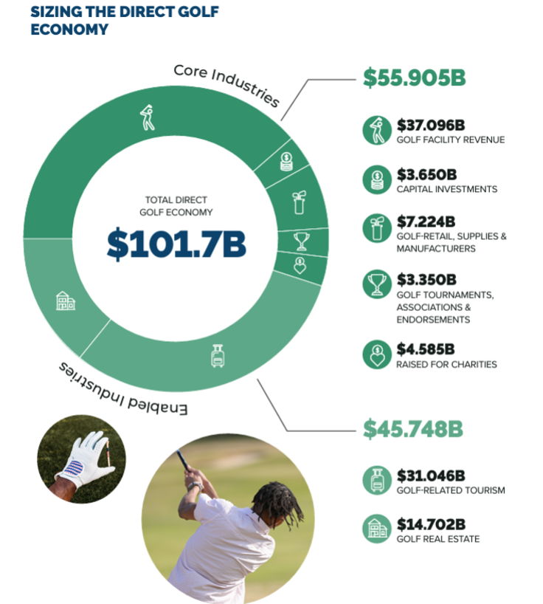
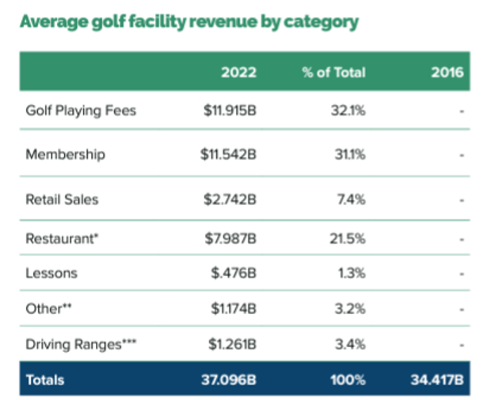
Economic Activity

Slide 28
Access PGA Family can be hosted on Saturdays which will allow more experienced golfers to have their own space on Sunday Allows families to have an inviting environment for them | Assistance Coaches available for those who want to develop skill further Standard employees surveilling making sure everyone is behaving accordingly and following rules
Assortment Having a vast variety of clubs, memberships and balls to personalize the experience and offer enough supplies for families to have a good time | Aesthetics Using nostalgia, sensory and visual appeals to create a feeling for the customers who come to PGA family and create lasting memories

Slide 29

Promotional Recommendations
Tailor the type of media to the promotional strategy it best fits.
Example: A well-known celebrity/influencer for Paid Media and well-known PGA Professional (i.e. Michael Block) for Owned Media.
Paid Media (Pull Strategy) | Maintain large reach.
Owned Media (Push Strategy) | Able to go more in depth about the program in order to sell it to the professionals.
Earned Media (Hybrid Strategy) | Should be able to do both of these things. PGA Professional Social Media/Word of Mouth Customer Reviews/Social Media Posts
Notes:
Think about the need for a push and or pull strategy approach that emphasized marketing PGA Family to professionals (push) and/or marketing the program to families (pull).

Slide 30
Product Recommendations
Attributes: Location —> Have courses nationwide with PGA Family program established at many courses accessible to all areas.
Consequences: Adventure —> Provide innovative technology to engage families and enhance the experience.
Value: Fun and Enjoyment —> Have stations across golf courses for families to have a fun and memorable experience.

Slide 31
QUESTIONS?

